Slide 1
TEACHER CUE
CFU
HINT
Scaffolding for students
MAKE THE CONNECTION
Allow students to make the connection

Slide 2
SWBAT describe properties of waves
TRACK WITH ME
READ WITH ME
I can describe transverse and longitudinal waves
I can draw and label a wave diagram

Slide 3


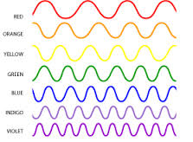

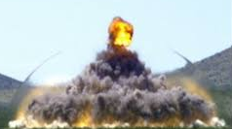

Slide 4
What are waves?
In groups of 4 compile a list of key words relating to waves and write them on the scrap paper
Include examples of waves, characteristics of waves and any thing else you can think of relating to waves.

Slide 5
What are waves?
Waves are the movement of ENERGY from one place to another.
They can be either transverse or longitudinal.
Waves can be demonstrated using a slinky.

Slide 6
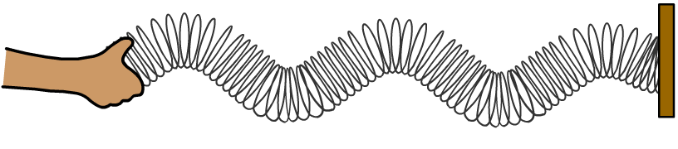
Transverse Waves
A Slinky can be used to model transverse waves, by moving one end of the Slinky up and down.
In a transverse wave, the coils do not travel in the same direction as the wave; each coil of the Slinky just vibrates up and down.
coils vibrate
up and down
source moves
up and down
direction of wave

Slide 7

Examples of transverse waves
All Electromagnetic waves are transverse
➔Light
Microwaves
Infrared
Radio
Other examples of transverse waves
➔ Water Waves

Slide 8
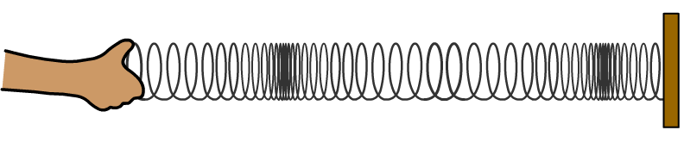
Longitudinal waves
A Slinky can be used to model longitudinal waves, by moving one end of the Slinky back and forth.
source moves
left and right
coils vibrate
left and right
direction of wave

Slide 9
MAKE THE CONNECTION
Examples of longitudinal waves: Sound wave Ultrasonic waves
The wave travels away from the source. The direction of the wave is the same as the movement of the source.
TEACHER CUE
Can you draw in your book a longitudinal and a transverse wave
In a longitudinal wave each coil of the Slinky vibrates in the same direction as the wave travels.
source moves
left and right
coils vibrate
left and right
direction of wave

Slide 10
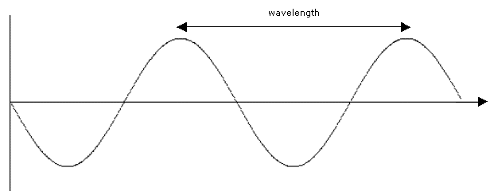
MAKE THE CONNECTION
Can you draw this in your book
Waves are usually represented on a wave diagram as shown below:
crest
amplitude
trough

Slide 11
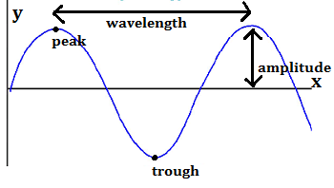
Wavelength
Wavelength is the distance from one peak to another
Measured in metres

Slide 12
Amplitude
Amplitude is the displacement of the wave from the original position
Measured in metres

Slide 13
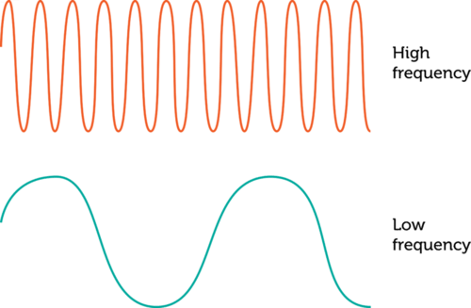
Frequency
Frequency is the amount of waves that pass a fixed point over time.
Measured in Hz (1 wave passing a fixed point over time)

Slide 14
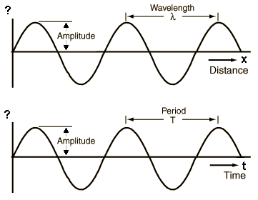
Wave Period
Time taken to complete one period
Measured in seconds

Slide 15
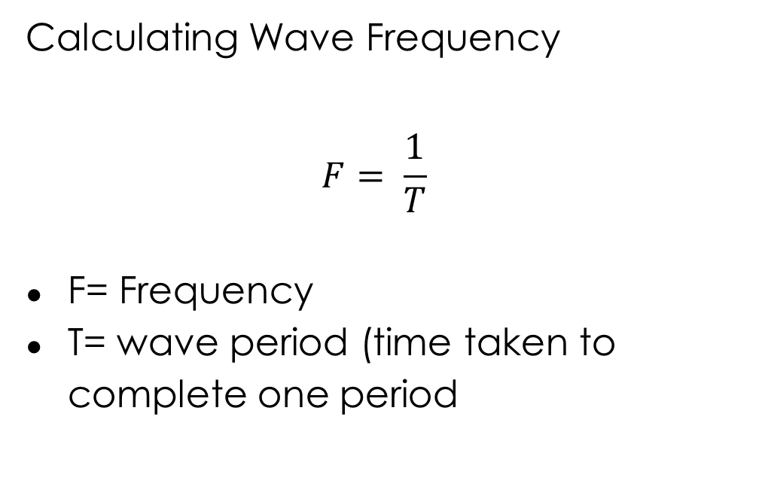
Calculating Wave Frequency
$$F= \frac{1}{T}$$
F= Frequency
T= wave period (time taken to complete one period

Slide 16
Questions
What does this represent 2.0 Hz? Frequency or amplitude
Which is measured in metres, wavelength or amplitude
Label a diagram of the different parts of the wave
Write a definition of amplitude, wavelength, wave frequency, wave period
Calculate the frequency of a wave that has a wave period of 0.5 seconds
Calculate the frequency of wave that has a wave period of 1.8 seconds

Slide 17
SWBAT describe properties of waves
TRACK WITH ME
READ WITH ME
I can describe transverse and longitudinal waves
I can draw and label a wave diagram

